Slide 1
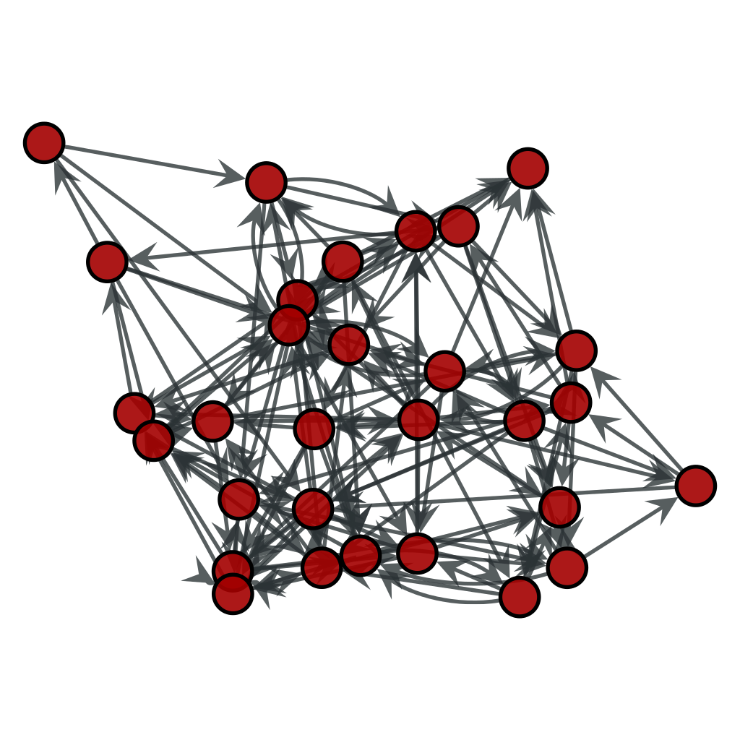
Truth Learning in Social and Adversarial Settings
By Amanda Wang, Julia Krizanova, Filip Uradnik, and Rhett Olson
Mentor: Professor Jie Gao

Slide 2
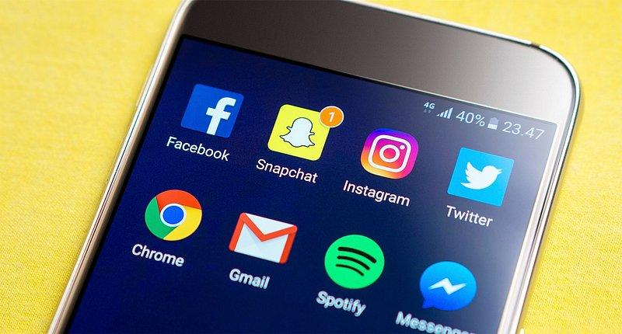

Motivation
You have imperfect information about the world
You are influenced by other people, also with imperfect information
Examples:
  Social media
  Panel Discussions

Slide 3
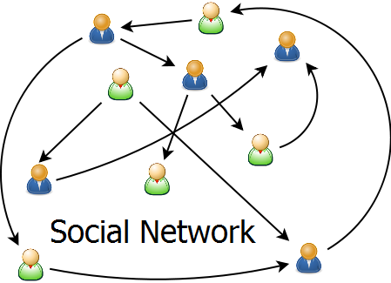
Setup
Social network structured as a graph.

Slide 4
Setup
Social network structured as a graph.
  Vertices = agents.
  Edges = which agents know each other.

Slide 5
Setup
Social network structured as a graph.
  Vertices = agents.
  Edges = which agents know each other.
Binary ground truth 𝜃.

Slide 6
Setup
Social network structured as a graph.
  Vertices = agents.
  Edges = which agents know each other.
Binary ground truth 𝜃.
Each agent v has an independent, private, and noisy measurement s_{v} of 𝜃.
Each agent v makes a prediction a_{v} of ground truth sequentially.
  based on private measurement & neighbors’ predictions.

Slide 7
Setup
Social network structured as a graph.
  Vertices = agents.
  Edges = which agents know each other.
Binary ground truth 𝜃.
Each agent v has an independent, private, and noisy measurement s_{v} of 𝜃.
Each agent v makes a prediction a_{v} of ground truth sequentially.
  based on private measurement & neighbors’ predictions.
Q: When is it possible for agents to learn a ground truth given a network topology, prediction order, and distribution of private measurements?

Slide 8
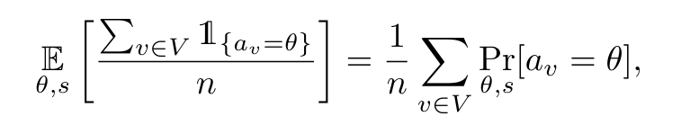
How to Measure Network Learning
Intuitively, we want to maximize the proportion of agents in the network predicting the ground truth correctly.
We define a networks expected learning rate as follows:
We want the expected learning rate to approach 1 for large networks.
Not as easy as it seems!

Slide 9
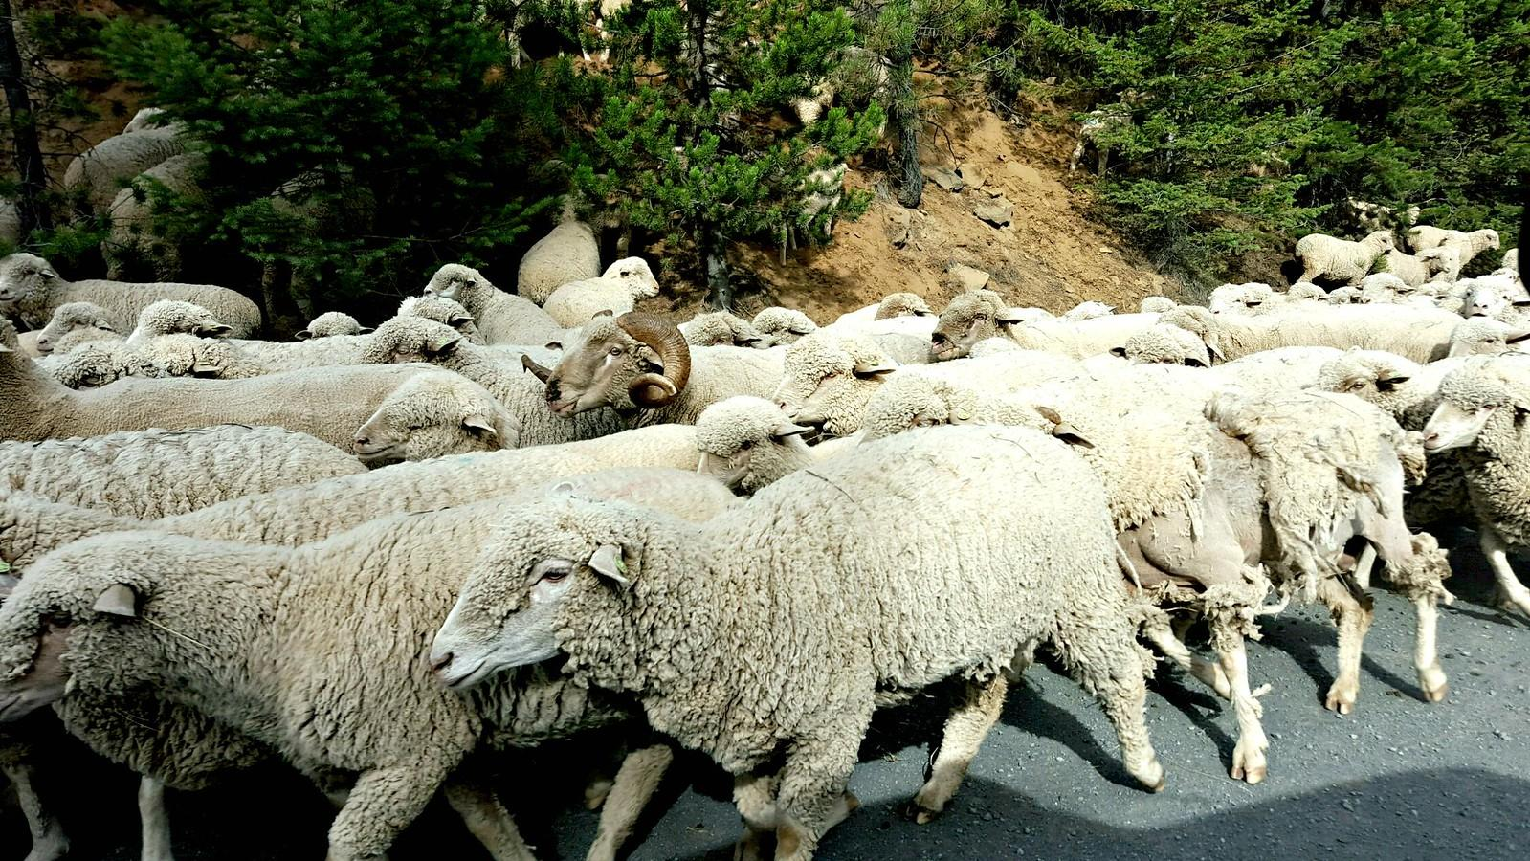
Information Cascades/Herding
Agents can become biased if one opinion appears to dominate among those it has seen.
Can lead nearly the entire group to stop using their own observations and instead copy previous decisions.
Notes:
Even in this basic vanilla setup, we can construct simple examples where most agents are unable to learn the ground truth with constant probability
can occur if the network is too dense (as we’ll see in the following example)

Slide 10

Cascade example
An urn contains either 1 blue + 2 red balls, or 1 red + 2 blue balls w/ equal probability.
Taking turns, each person:
randomly picks a ball to observe in private (with replacement)
publicly states if they think the urn is majority red or majority blue
?
Notes:
Specify that here the ground truth is binary and is “majority red” or “majority blue”
By “public announcement” we are implicitly specifying a complete graph, where agents see the predictions of all agents which are earlier in the decision ordering

Slide 11
Cascade example
Suppose 2 blue + 1 red.
Person 1 observes red. Announces “majority red”.
Person 2 observes red. Announces “majority red”.
3. Person 3 observes blue.
Announces “majority red”.
No new information!
4. Person 4 observes xx. Announces “majority red”.
…
Notes:
Suppose a setting where a box contains 2 blue balls and only one red ball.
During the first draw, this person only knows their private information, so after drawing a red ball, the public announcement will naturally be “majority red”.
Here, it may happen that the second person will as well draw a red ball. Knowing the public announcement of the precious player they will also announce “majority red”.
It can be observed that after those two draws, the tie is being formed.
This means that no matter what ball color the third and fourth person observe, no new information is going to be obtained as they will both announce “majority red”.
- This tie formation happens with constant probability, in this exact case being 1/9.
This shows that even if all agents are perfectly rational, there is a possibility of disregard of one's private signal.

Slide 12
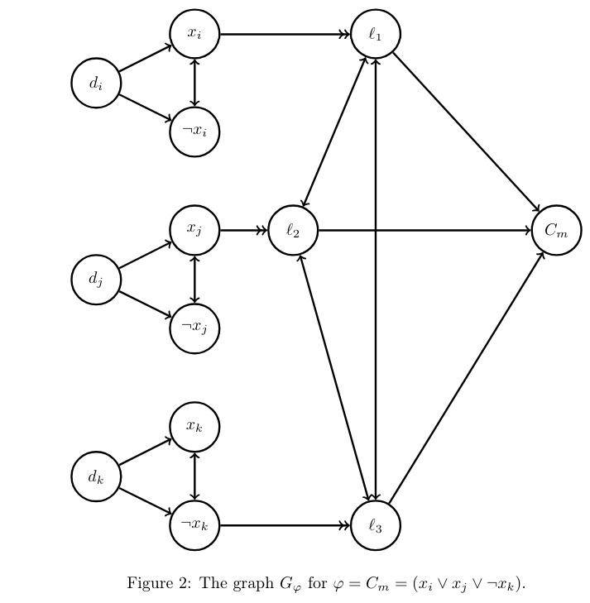
Progress: NP-Hardness
Decision Problem: Given a social network and some threshold, does there exists a decision order where the network’s learning rate meets the threshold?
We have a reduction from 3-SAT for this problem where nodes aggregate information via majority vote.
  Reduction relies on using directed and multi-edges
  Still need to adapt computations for Bayesian information aggregation

Slide 13
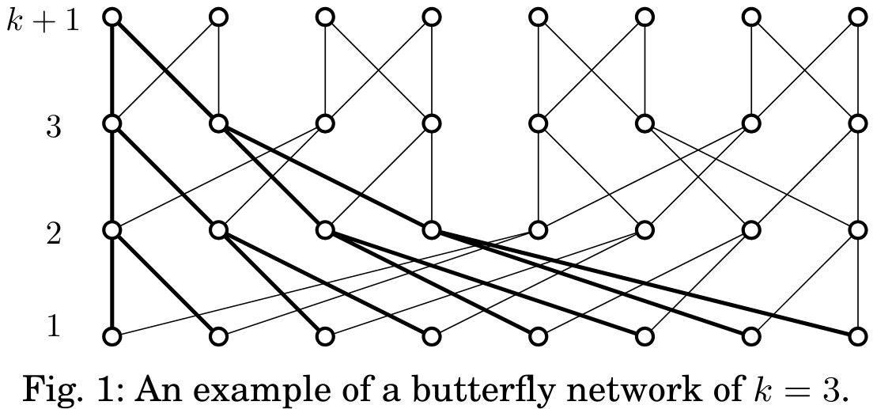
Progress: Robustness Against Adversaries
For large instances of specific networks, we aim to show that adversarial agents have negligible effect on the learning rates of non-adversaries in the network.
Celebrity Network
Binary Butterly Network
…
. . . . . .
Complete Bipartite Graph with M celebrities and N commoners
Seems to be robust against O(N) adversarial commoners.
Network of k+ 1 levels, with 2^k nodes on each.
Seems to be robust in specific layouts where O(log n)
of the nodes are adversaries
Notes:
Rhett’s note: At the time of this draft of the slides, neither proof is quite complete, but I hope to be done by the time of the presentation.

Slide 14
Future Directions
Bayesian model vs. majority vote: does a Bayesian model always achieve equal better learning rate?
Can social networks help in settings where the majority of people have false private measurements of the truth?
Notes:
I might skip this if I run out of time.

Slide 15
Acknowledgements
This work made possible by the Rutgers DIMACS REU program. Thank you to faculty and staff who work to keep the program running. Thank you as well to the National Science Foundation for funding this project through the grant CNS-2150186 and the REU supplement to NSF 2208663 -Collaborative Research: AF: Small: Promoting Social Learning Amid Interference in the Age of Social Media.
This work was carried out while the authors Filip Uradnik and Julia Krizanova were participants in the 2024 DIMACS REU program at Rutgers University, CNS-2150186. The authors were supported by CoSP, a project funded by European Union’s Horizon 2020 research and innovation programme, grant agreement No. 823748
Thank you as well to Professor Jie Gao for her help and leadership on this project.
Notes:
Lazaros sent an email about including acknowledgements for our presentations. Feel free to add anything I might have missed.

